Slide 1
Random Process, Analog Modulation

Slide 2

Random Variables and Distributions
For a random variable X, the cumulative probability function:
Probability density function:
Expectation:
Moment:
Variance:

Slide 3
Random Process
Random process：
Stationary random process：
Ergodicity ：
For a random process x(t), for an arbitrary t₁，x(t₁) is a random variable.
The expectation of x(t) is a constant. Its autocorrelation only depends on the time difference.
Expectation equals the time-average. An abtirary realization of the random process will go through all the possible states.
Notes:
统计特性不变

Slide 4
Random Process
Expectation, autocorrelation and power spectral density of a stationary random process x(t):
Notes:
画图

Slide 5
Random Process
For an ergodic random process：
Notes:
画图

Slide 6
Random Process
For a white random process x(t)：
The thermal noise can be modeled as a white Gaussian random process.
Notes:
画图

Slide 7
Random Process
Lowpass random process：
Bandlimited：
Bandpass random process
The power spectrum is large in the vicinity of f=0, and small at high frequencies.
If the power spectrum is zero for |f|>B.
The power spectrum is larger in the band of frequencies centered at +/-f₀. If B<< f₀, it is called narrow band.
Notes:
统计特性不变

Slide 8
Random Process
Problem 2.9：
Consider of generating samples of a lowpass random process by passing a white noise sequence {x_{n}} through a lowpass filter. The input sequence is an i.i.d. sequence of uniformly distributed randon variable on the interval (-1/2,1/2). The lowpass filter is given as follows:
Notes:
统计特性不变

Slide 9
Random Process
Step 1：Initialization
N=1000; % The maximum value of n
M=50;
Rxav=zeros(1,2*M+1);
Ryav=zeros(1,2*M+1);
Sxav=zeros(1,2*M+1);
Syav=zeros(1,2*M+1);
Step 2：Generate the sequence, pass the filter
X=rand(1,N)-(1/2);
%Generate a uniform number sequence on (-1/2,1/2)
Y(1)=X(1);
for n=2:N, Y(n)=0.9*Y(n-1)+X(n); end;
% Note that Y(n) means Y(n-1).
Notes:
统计特性不变

Slide 10
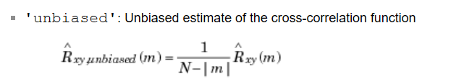
Random Process
Step 3：Calculate the spectrum, autocorrelation for each realization
Rx=xcorr(X,'unbiased'); % autocorrelation of {Xn}
Rx=Rx(950:1050); %Original Rx, m is -999 to 999
Ry=xcorr(Y,'unbiased'); % autocorrelation of {Yn}
Ry=Ry(950:1050);
Sx=fftshift(abs(fft(Rx))); % power spectrum of {Xn}
Sy=fftshift(abs(fft(Ry))); % power spectrum of {Yn}
Notes:
统计特性不变

Slide 11
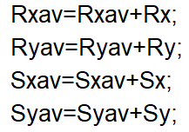
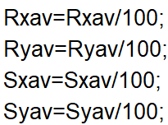
Random Process
Step 4：Calculate average over 100 runtime, plot them
figure(1)
subplot(121)
plot(-M:M,Rxav);
subplot(122)
plot(-M:M,Ryav);
figure(2)
subplot(121)
plot(-0.5:0.01:0.5,Sxav);
subplot(122)
plot(-0.5:0.01:0.5,Syav);
Notes:
统计特性不变

Slide 12
Analog Modulation
We mainly discuss the amplitude modulation, including:
DSB-AM
Conventional AM(常规AM)
SSB-AM

Slide 13

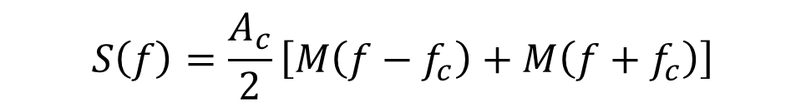
Amplitude Modulation
DSB-AM
For a baseband signal m(t)，the DSB-AM signal is：
The spectrum is：
$$s\left(t\right)=Acm\left(t\right)cos\left(2πf_{c}t\right)$$
$$S\left(f\right)=\frac{A_{c}}{2}\left[M\left(f−f_{c}\right)+M\left(f+f_{c}\right)\right]$$

Slide 14
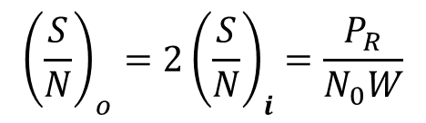
Amplitude Modulation
Demodulation of DSB-AM
- The coherent demodulation of the DSB-AM signal is given by
- The SNR of the demodulator output (i.e., the SNR of the baseband signal) versus demodulator input (i.e., the receive SNR ):
$${\left(\frac{S}{N}\right)}_{o}=2{\left(\frac{S}{N}\right)}_{i}=\frac{P_{R}}{N_{0}W}$$

Slide 15

Amplitude Modulation
Conventional AM
For a baseband signal m(t)，the conventional AM signal is：
The spectrum is：
$$s\left(t\right)=Ac(1+am\left(t\right))cos\left(2πf_{c}t\right)$$
$$S\left(f\right)=\frac{A_{c}}{2}\left[δ\left(f−f_{c}\right)+aM\left(f−f_{c}\right)+δ\left(f−f_{c}\right)+aM\left(f+f_{c}\right)\right]$$

Slide 16
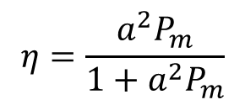

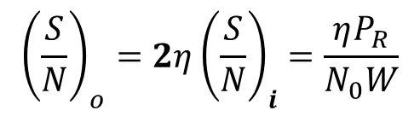
Amplitude Modulation
Demodulation of conventional AM
- Coherent demodulation: similar to DSB-AM. Note that the dc signal should be removed.
$$\frac{a^{2}P_{m}}{1+a^{2}P_{m}}$$
- Non-coherent demodulation: Envelop detector.
- The SNR of the demodulator output (i.e., the SNR of the baseband signal) versus demodulator input (i.e., the receive SNR ):
$${\left(\frac{S}{N}\right)}_{o}=2η{\left(\frac{S}{N}\right)}_{i}=\frac{ηP_{R}}{N_{0}W}$$
$$η=\frac{a^{2}P_{m}}{1+a^{2}P_{m}}$$

Slide 17

Amplitude Modulation
SSB-AM
For a baseband signal m(t)，the SSB-AM signal is：
The spectrum is：
$$Re\left[\left(m\left(t\right)+j\hat{m}\left(t\right)\right)e^{j2πf_{c}t}\right]$$

Slide 18
Amplitude Modulation
Demodulation of SSB-AM
- The coherent demodulation of the SSB-AM signal is given by:

Slide 19


Amplitude Modulation
Demodulation of SSB-AM
The SNR of the demodulator output (i.e., the SNR of the baseband signal) versus demodulator input (i.e., the receive SNR ):
Depending on the bandpass filter before demodulator.
If the bandwidth of bandpass filter for SSB is ½ that for DSB, then ${\left(\frac{S}{N}\right)}_{i}=\frac{P_{R}}{N_{0}W}$.
Idealy, SSB has similar output SNR compared with DSB under the same P_{R} and N₀.
${\left(\frac{S}{N}\right)}_{o}={\left(\frac{S}{N}\right)}_{i} where{\left(\frac{S}{N}\right)}_{i}=\frac{P_{R}}{{2N}_{0}W}$ or ${\left(\frac{S}{N}\right)}_{i}=\frac{P_{R}}{N_{0}W}$

Slide 20
Amplitude Modulation
Example 3.5 DSB-AM demodulation
The message is given as follows:
Using DSB-AM modulation, the modulated signal is denoted by u(t). t₀=0.15s, fc=250Hz, the lowpass filter in demodulator is [-150Hz,150Hz]. The power spectral density of thermal noise is N0/2, where N0=0.0005.
(1)Plot the message and the modulated signal
(2)Plot the demodulated signal.
(3)Calculate the output SNR.

Slide 21
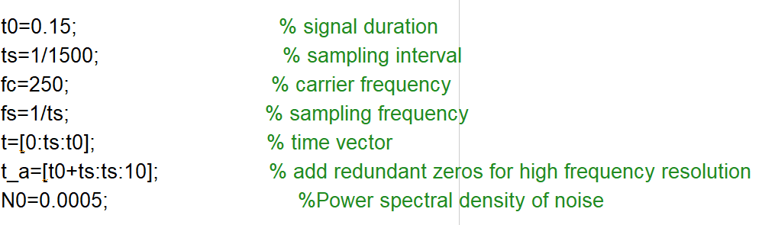
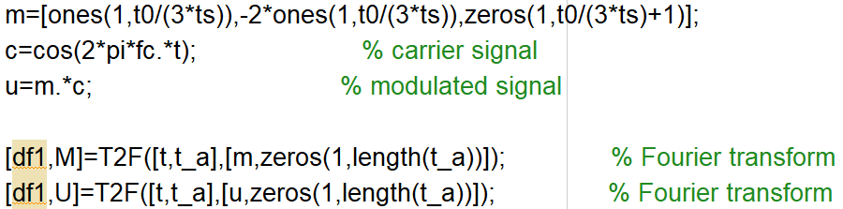
Amplitude Modulation
Step 1: Intitialization
Step 2: Message signal and modulated signal

Slide 22
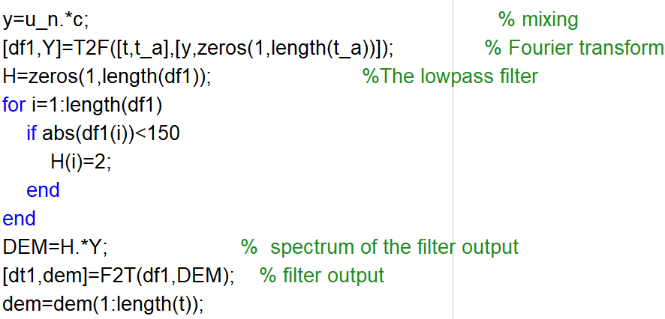
Amplitude Modulation
Step 3: Add thermal noise
Step 4: Demodulation

Slide 23
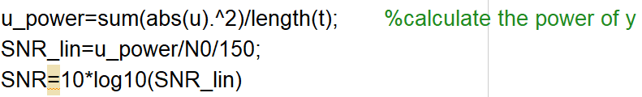
Amplitude Modulation
Step 5: Calculate the output SNR of the demodulator

Slide 24
Amplitude Modulation
Example 3.7 LSSB-AM demodulation
The message is given as follows:
Using LSSB-AM modulation, the modulated signal is denoted by u(t). t₀=0.15s, fc=250Hz, the lowpass filter in demodulator is [-150Hz,150Hz]. The power spectral density of thermal noise is N0/2, where N0=0.0005.
(1)Plot the message and the modulated signal
(2)Plot the demodulated signal.
(3)Calculate the output SNR.

Slide 25
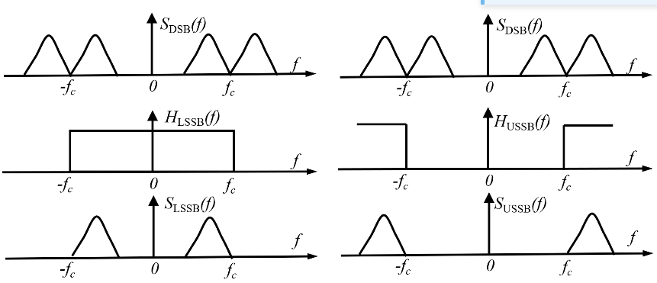
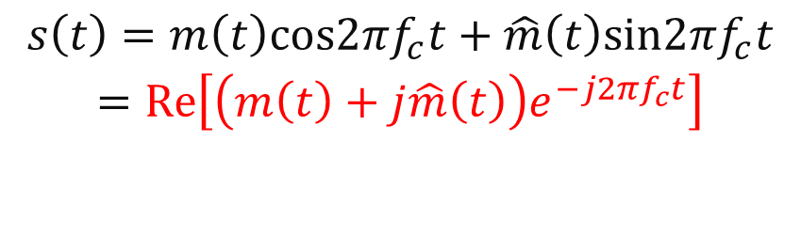
Amplitude Modulation
Example 3.7 LSSB-AM demodulation
$$\begin{matrix}s\left(t\right)=m\left(t\right)cos2πf_{c}t+\hat{m}\left(t\right)sin2πf_{c}t \\ =Re\left[\left(m\left(t\right)+j\hat{m}\left(t\right)\right)e^{−j2πf_{c}t}\right] \\ \\ \end{matrix}$$

Slide 26
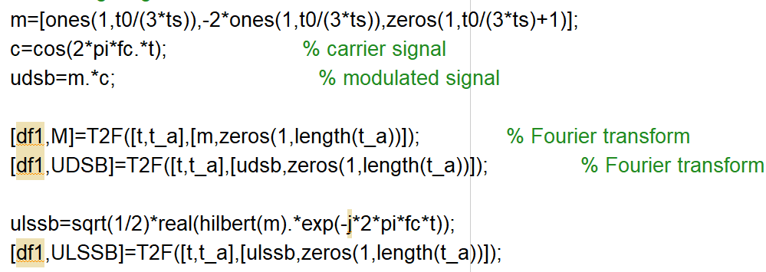
Amplitude Modulation
Step 2: Message signal and modulated signal
DSB:$s\left(t\right)=m\left(t\right)cos2πf_{c}t$
SSB:$s\left(t\right)=m\left(t\right)cos2πf_{c}t+\hat{m}\left(t\right)sin2πf_{c}t$

Slide 27

Amplitude Modulation
Step 3: Add thermal noise

Slide 28
Amplitude Modulation
Example 3.3 Conventional AM demodulation
The message is given as follows:
Using conventional AM modulation, the modulated signal is denoted by u(t). t₀=0.15s, fc=250Hz, modulation index a=0.85. The lowpass filter in demodulator is [-150Hz,150Hz]. The power spectral density of thermal noise is N0/2, where N0=0.0005.
(1)Plot the message and the modulated signal
(2)Plot the demodulated signal.
(3)Calculate the output SNR.

Slide 29
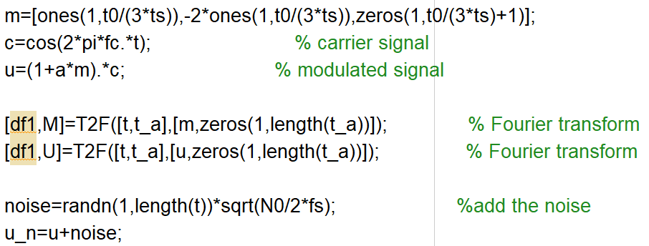

Amplitude Modulation
Step 2: Message signal and modulated signal
$$s\left(t\right)=(1+am\left(t\right))cos\left(2πf_{c}t\right)$$

Slide 30
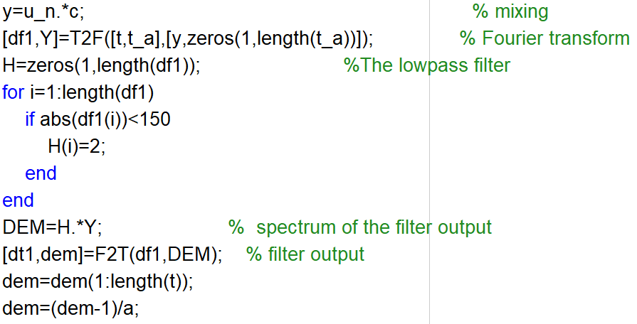

Amplitude Modulation
Step 4: Demodulation
$$s\left(t\right)=(1+am\left(t\right))cos\left(2πf_{c}t\right)$$

Slide 31
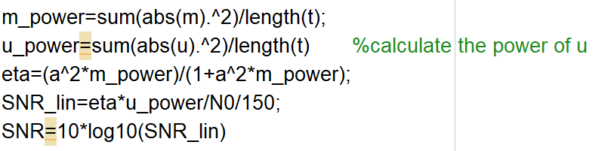
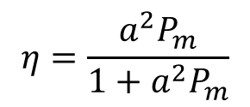
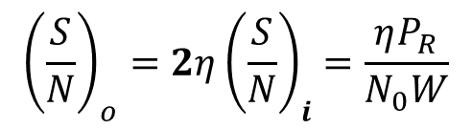
Amplitude Modulation
Step 5: Calculate the output SNR of the demodulator
$${\left(\frac{S}{N}\right)}_{o}=2η{\left(\frac{S}{N}\right)}_{i}=\frac{ηP_{R}}{N_{0}W}$$
$$η=\frac{a^{2}P_{m}}{1+a^{2}P_{m}}$$

